Slide 1
Transport Company

Slide 2
Introduction
It maintains the information about the vehicle installed in a transport company with sufficient detail of vehicle’s owner, contact no. and Insurance detail and all the available transport services provided by the company.
User can easily get all the details about the company because of the GUI(Graphical user interface).
Mainly there are three types of user for this app – Admin, Manager and Visitors.
According to their rights each user has its own rights to access in different parts of the app. User can transport their goods by filling the necessary details like address, type of goods etc.

Slide 3
Objective & Scope of the Project
To provide a user friendly and Graphical User Interface (GUI).
The proposed system should maintain all the records and should generate the required reports and information when required.
To provide graphical and user-friendly interface to interact with a centralized database based on client-server architecture.
To identify the critical operation procedure and possibilities of simplification using modern IT tools and practices.

Slide 4
Tools to Implement Project
During coding and design of the software Project, Java NetBeans IDE, a powerful front-end tool is used for getting Graphical User Interface (GUI) based integrated platform and coding simplicity. As a back-end a powerful, open source RDBMS, My SQL is used as per requirement.

Slide 5
Hardware & Software requirement
Hardware Requirement-
◻ Intel i3 processor or similar processor based PC at Client/Server end.
◻ Standard I/O devices like Keyboard and Mouse etc.
◻ Printer is needed for hard-copy reports.
◻ Local Area Network(LAN) is required for Client-Server Installation
Software Requirement-
◻ Windows 10 is desirable.
◻ NetBeans Ver 8.0.2 or higher should be installed with JDK and JVM.
◻ MySQL Ver 6.1 with Final_Project Database must be present at machine.

Slide 6
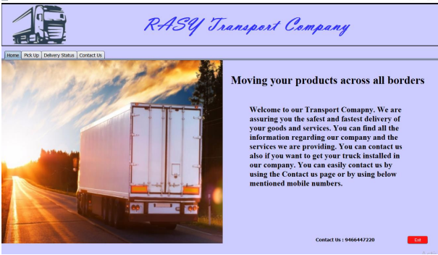
System Design & Development
User dashboard - Home Interface:

Slide 7
Database Design:
The software maintain named Transport Company(RASY) contains following tables: Table Design:
The database of Transport Company(RASY) contains 4 tables. The tables are normalized to minimize the redundancies of data and enforcing the validation rules of the organization. The name of the tables and structures are given below :
• Delivery
• Manager
• Truck
• User

Slide 8
Problem Definition & Analysis
The hardest part of building a software system is deciding precisely what to build. No other part of the conceptual work is as difficult as establishing the detailed technical requirement. Defining and applying good, complete requirements are hard to work, and success in this endeavor has eluded many of us. Yet, we continue to make progress.
Problem definition and Analysis is the activity that encompasses learning about the problem to be solved, understanding the needs of customer and users, trying to find out who the user really is, and understanding all the constraints on the solution.

Slide 9
THANKS!

